Slide 1
Restaurant App
Nino, Collins, Cristian

Slide 2
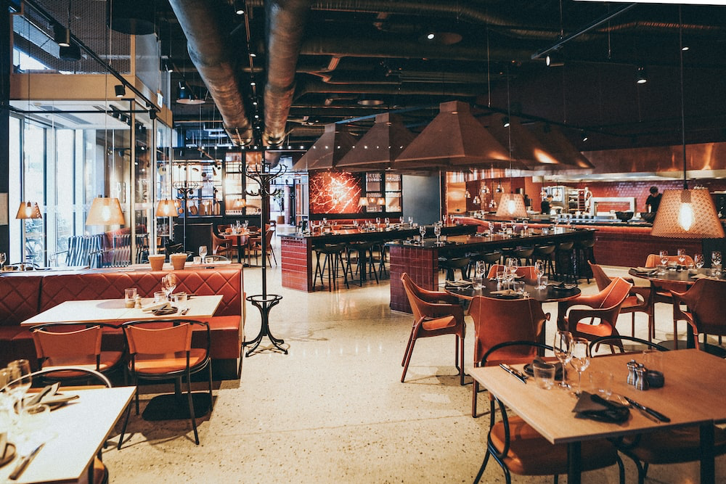
Purpose of the Restaurant app
The goal of the Restaurant Application is to allow employees of any restaurant access to more efficient modes of management of the workflow. With features such as seating options and arrangement , order status , menu etc.

Slide 3

Chef
Chef will be responsible for:
View orders
Set order status
Time on order

Slide 4

Manager
General Manager will be responsible for:
Setting the menu
Ordering inventory
Viewing Inventory
Set Inventory

Slide 5

Waiter
Waiter will be responsible for:
Seating
Create orders
View current orders
Process transactions

